Slide 1
Fundamentals Physics
Tenth Edition
Halliday
Chapter 5
Force and Motion–I

Slide 2
5-1 Newton's First and Second Laws (1 of 20)
Learning Objectives
5.01 Identify that a force is a vector quantity and thus has both magnitude and direction and also components.
5.02 Given two or more forces acting on the same particle, add the forces as vectors to get the net force.
5.03 Identify Newton's first and second laws of motion.
5.04 Identify inertial reference frames.

Slide 3
5-1 Newton's First and Second Laws (2 of 20)
5.05 Sketch a free-body diagram for an object, showing the object as a particle and drawing the forces acting on it as vectors anchored to the particle.
5.06 Apply the relationship between net force on an object, its mass, and the produced acceleration.
5.07 Identify that only external forces on an object can cause the object to accelerate.

Slide 4
5-1 Newton's First and Second Laws (3 of 20)
A force:
Is a “push or pull” acting on an object
Causes acceleration
We will focus on Newton's three laws of motion:
Newtonian mechanics is valid for everyday situations
It is not valid for speeds which are an appreciable fraction of the speed of light
It is not valid for objects on the scale of atomic structure
Viewed as an approximation of general relativity

Slide 5
5-1 Newton's First and Second Laws (4 of 20)
Before Newtonian mechanics:
Some influence (force) was thought necessary to keep a body moving
The “natural state” of objects was at rest
This seems intuitively reasonable (due to friction)
But envision a frictionless surface
Does not slow an object
The object would keep moving forever at a constant speed
Friction is a force!

Slide 6
5-1 Newton's First and Second Laws (5 of 20)
Newton's First Law: If no force acts on a body, the body's velocity cannot change: that is, the body cannot accelerate.

Slide 7
5-1 Newton's First and Second Laws (6 of 20)
Characteristics of forces:
Unit: N, the newton;
Acceleration of a mass is proportional to the exerted force
Forces are vectors
Net force is the vector sum of all forces on an object
Principle of superposition for forces:
A net force has the same impact as a single force with identical magnitude and direction
So we can restate more correctly:

Slide 8
5-1 Newton's First and Second Laws (7 of 20)
Newton's First Law: If no net force acts on a body
the body's velocity cannot change; that is, the body cannot accelerate.

Slide 9
5-1 Newton's First and Second Laws (8 of 20)
Newton's first law is not true in all frames
Inertial frames:
An inertial reference frame is one in which Newton's laws hold.
(a): a frictionless puck, pushed from the north pole, viewed from space
(b): the same situation, viewed from the ground
Over long distances, the ground is a noninertial frame
In (b), a fictitious force would be needed to explain deflection

Slide 10
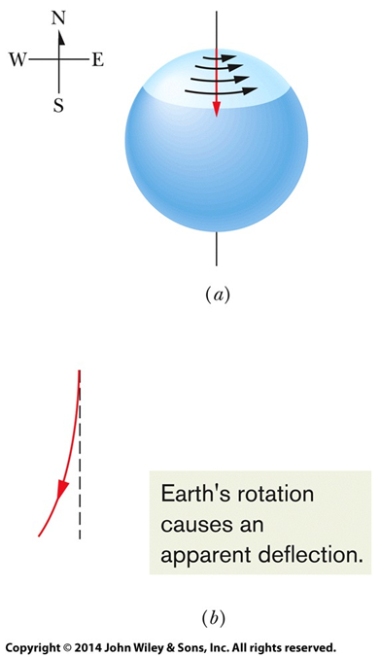
5-1 Newton's First and Second Laws (9 of 20)
Figure 5-2

Slide 11
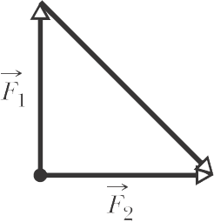
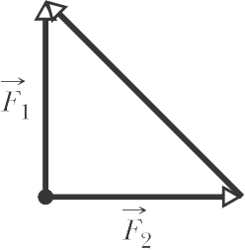
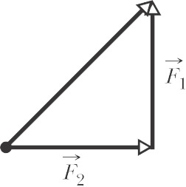
5-1 Newton's First and Second Laws (10 of 20)
Generally, assume the ground is an inertial frame
Checkpoint 1
Which of the figure's six arrangements correctly show the vector
addition of forces
to yield the third vector, which is
meant to represent their net force
(a)
(b)
(c)

Slide 12
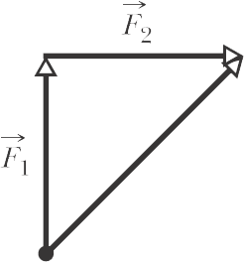
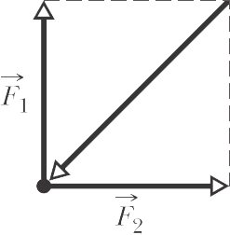
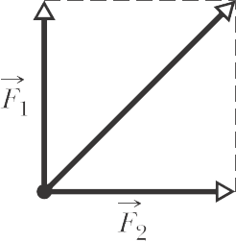
5-1 Newton's First and Second Laws (11 of 20)
(d)
(e)
(f)
Answer: (c), (d), (e)

Slide 13
5-1 Newton's First and Second Laws (12 of 20)
What is mass?
“the mass of a body is the characteristic that relates a force on the body to the resulting acceleration”
Mass is a measure of a body’s resistance to a change in motion (change in velocity)
It is not the same as weight, density, size etc.
Mass is inversely proportional to acceleration

Slide 14
5-1 Newton's First and Second Laws (13 of 20)
Example Apply an 8.0 N force to various bodies:
​
​
​
​

Slide 15
5-1 Newton's First and Second Laws (14 of 20)
Summarize these behaviors as:
Newton's Second Law: The net force on a body is equal to the product of the body's mass and its acceleration.
As an equation, we write:
Equation (5-1)
Identify the body in question, and only include forces that act on that body!
Separate the problem axes (they are independent):
Equation (5-2)

Slide 16
5-1 Newton's First and Second Laws (15 of 20)
The acceleration component along a given axis is caused only by the sum of the force components along that same axis, and not by force components along any other axis.

Slide 17
5-1 Newton's First and Second Laws (16 of 20)
If the net force on a body is zero:
Its acceleration is zero
The forces and the body are in equilibrium
But there may still be forces!
Units of force:

Slide 18
5-1 Newton's First and Second Laws (17 of 20)
Table 5-1 Units in Newton's Second Law (Equations. 5-1 and 5-2)
System | Force | Mass | Acceleration
S I | newton (N) | kilogram (kg) | metre per second squared
C G S ª | dyne | gram (g) | Centimetre per second squared
British ^{b} | pound (lb) | slug | feet per second squared

Slide 19
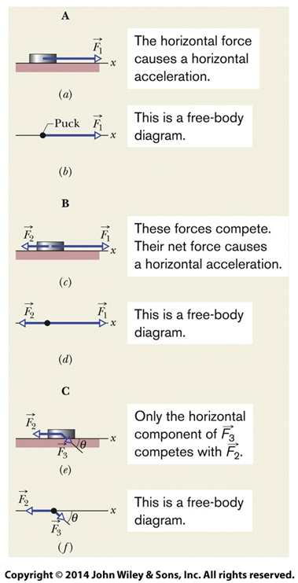
5-1 Newton's First and Second Laws (18 of 20)
To solve problems with forces, we often draw a free body diagram
The only body shown is the one we are solving for
Forces are drawn as vector arrows with their tails on the body
Coordinate system shown
Acceleration is Never part of a free body diagram – only forces on a body are present.
Figure 5-3

Slide 20
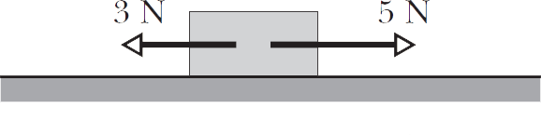
5-1 Newton's First and Second Laws (19 of 20)
Checkpoint 2
The figure here shows two horizontal forces acting on a block on a
frictionless floor. If a third horizontal force
also acts on the
block, what are the magnitude and direction of
when the block
is (a) stationary and (b) moving to the left with a constant speed of 5 m/s?
Answer: F₃ = 2 N to the left in both cases

Slide 21
5-1 Newton's First and Second Laws (20 of 20)
A system consists of one or more bodies
Any force on the bodies inside a system exerted by bodies outside the system is an external force
Net force on a system = sum of external forces
Forces between bodies in a system: internal forces
Not included in a F B D of the system since internal forces cannot accelerate the system
Note: do not confuse a free body diagram of an entire system with free body diagrams of individual bodies within a system.

Slide 22
5-2 Some Particular Forces (1 of 14)
Learning Objectives
5.08 Determine the magnitude and direction of gravitational force on a mass, for a given free-fall acceleration.
5.09 Identify that weight is the magnitude of the net force required to prevent a body from falling freely, measured by the frame of ground.
5.10 Identify that a scale gives an object’s weight when the measurement is done in an inertial frame but not in an accelerating frame, where it gives an apparent weight.

Slide 23
5-2 Some Particular Forces (2 of 14)
5.11 Determine the magnitude and direction of the normal force on an object when the object is pressed or pulled onto a surface.
5.12 Identify that the force parallel to the surface is a frictional force that appears when the object slides or attempts to slide.
5.13 Identify that a tension force is said to pull at both ends of a cord (or a cord-like object) when the cord is taut.

Slide 24
5-2 Some Particular Forces (3 of 14)
The gravitational force:
A pull that acts on a body, directed toward a second body
Generally we consider situations where the second body is Earth
In free fall (y direction, with no drag from the air):
Equation (5-8)
This force still acts on a body at rest!
We can write it as a vector:
Equation (5-9)

Slide 25
5-2 Some Particular Forces (4 of 14)
Weight:
The name given to the gravitational force that one body (like the Earth) exerts on an object
It is a force measured in newtons (N)
It is directed downward towards the center
The weight W of a body is equal to the magnitude F_{g} of the gravitational force on the body.

Slide 26
5-2 Some Particular Forces (5 of 14)
Example To relate weight to mass, consider an apple in free fall. The only force on the apple is the gravitational force which results in an acceleration of g. Applying Newton’s 2nd Law
Thus,

Slide 27
5-2 Some Particular Forces (6 of 14)
Measuring weight:
Use a balance to compare a body to known masses, find its mass, and compute its weight
Use a spring scale that measures weight on a calibrated scale
Weight is not the same as mass: a pan balance will read the same for different values of g, a scale will read differently for different values of g
Weight must be measured when the body is not accelerating vertically
E.g., in your bathroom, or on a train
But not in an elevator

Slide 28
5-2 Some Particular Forces (7 of 14)
The normal force:
If you are standing on a surface, the push back on you from the surface (due to deformation) is the normal force
Normal means perpendicular
When a body presses against a surface, the surface (even a seemingly rigid one) deforms and pushes on the body with a
normal force
that is perpendicular to the surface.

Slide 29
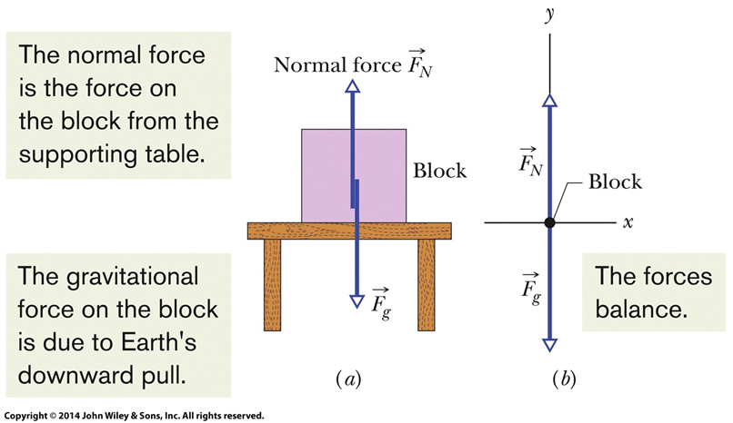
5-2 Some Particular Forces (8 of 14)
Figure 5-7

Slide 30
5-2 Some Particular Forces (9 of 14)
Example Normal force for a block resting on a horizontal surface that is:
Accelerating vertically at a_{y}:
Equation (5-13)
Vertically at rest:
Equation (5-14)

Slide 31
5-2 Some Particular Forces (10 of 14)
Checkpoint 3
In Fig. 5-7, is the magnitude of the normal force
greater than, less than, or equal to mg if the block and table are in an elevator moving upward (a) at constant speed and (b) at increasing speed?
Answer:
(a) equal to mg (no acceleration)
(b) greater than mg (see 5-13, with positive acceleration)

Slide 32
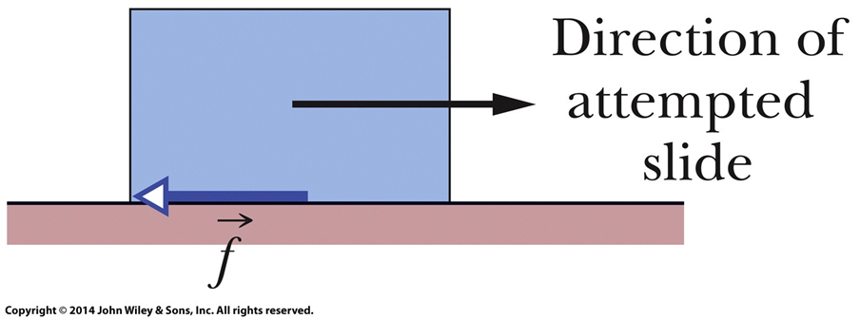
5-2 Some Particular Forces (11 of 14)
Frictional force or friction:
Occurs when one object slides or attempts to slide over another
Directed along the surface, opposite to the direction of intended motion
Figure 5-8

Slide 33
5-2 Some Particular Forces (12 of 14)
Tension force:
A cord (or rope, etc.) is attached to a body and pulled taut
Cord pulls on the body with force T directed along the cord
The cord is said to be under tension
The tension in the cord is T
A massless and unstretchable cord exists only as a connection between two bodies
It pulls on both with the same force, T
True even if the bodies and cord are accelerating, and even if the cord runs around a massless, frictionless pulley
These are useful simplifying assumptions

Slide 34
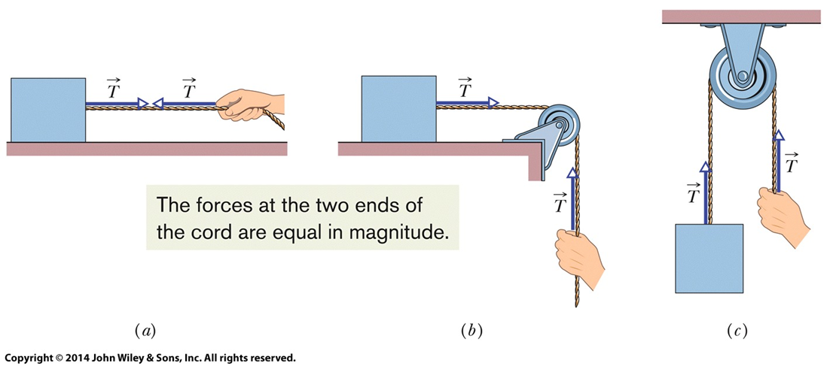
5-2 Some Particular Forces (13 of 14)
Figure 5-9

Slide 35
5-2 Some Particular Forces (14 of 14)
Checkpoint 4
The suspended body in Fig. 5-9c weighs 75 N. Is T equal to, greater than, or less than 75 N when the body is moving upward (a) at constant speed, (b) at increasing speed, and (c) at decreasing speed?
Answer:
(a) equal to 75 N
(b) greater than 75 N
(c) less than 75 N

Slide 36
5-3 Applying Newton's Laws (1 of 10)
Learning Objectives
5.14 Identify Newton's third law of motion and third-law of force pairs.
5.15 For an object that moves vertically or on a horizontal or inclined plane, apply Newton's second law to a free-body diagram of the object.
5.16 For an arrangement where a system of several objects moves rigidly together, draw a free-body diagram and apply Newton's second law for the individual objects and also for the system taken as a composite object.

Slide 37
5-3 Applying Newton's Laws (2 of 10)
Objects interact when they push or pull on each other:
Newton's Third Law: When two bodies interact, the forces on the bodies from each other are always equal in magnitude and opposite in direction.
We can write this law as a scalar or vector relation:
Equation (5-15)
We call these two forces a third-law force pair
Any time any two objects interact, there is a third-law force pair

Slide 38
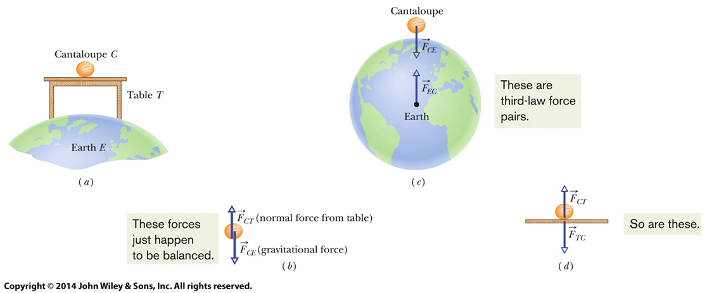
5-3 Applying Newton's Laws (3 of 10)
Figure 5-11

Slide 39
5-3 Applying Newton's Laws (4 of 10)
Third-law force pairs:
This includes the gravitational forces between Earth and the cantaloupe!

Slide 40
5-3 Applying Newton's Laws (5 of 10)
Checkpoint 5
Suppose that the cantaloupe and table of Fig. 5-11 are in an elevator cab
that begins to accelerate upward, (a) Do the magnitudes of
increase, decrease, or stay the same? (b) Are those two forces still equal in magnitude and opposite in direction? (c) Do the magnitudes of
increase, decrease, or stay the same? (d) Are those two
forces still equal in magnitude and opposite in direction?
Answer:
(a) they increase
(b) yes
(c) they begin to decrease slowly (the gravitational force of Earth decreases with height—negligible in an actual elevator)
(d) yes

Slide 41
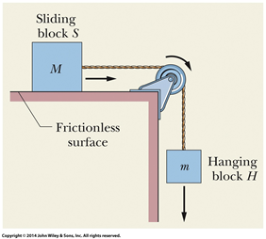
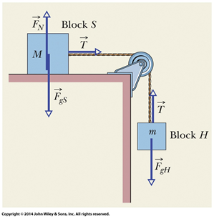
5-3 Applying Newton's Laws (6 of 10)
Sample Problem A block of mass M = 3.3 kg, connected by a cord and pulley to a hanging block of mass m = 2.1 kg, slides across a frictionless surface
Figure 5-12
Figure 5-13

Slide 42
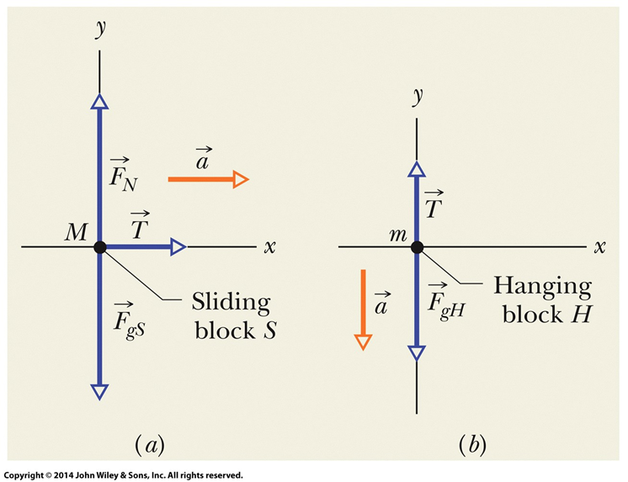
5-3 Applying Newton's Laws (7 of 10)
Draw the forces involved
Treat the string as unstretchable, the pulley as massless and frictionless, and each block as a particle
Draw a free-body diagram for each mass
Apply Newton's 2nd law (F = ma) to each block → 2 simultaneous equations.
Eliminate unknowns (T) that are the same, and solve for the acceleration
Figure 5-14

Slide 43
5-3 Applying Newton's Laws (8 of 10)
For the sliding block:
Equation (5-18)
For the hanging block:
Equation (5-20)
Combining we get:
Equation (5-21)
Equation (5-22)

Slide 44
5-3 Applying Newton's Laws (9 of 10)
Plugging in we find
Does this make sense? Check that dimensions are correct, check that a < g, check that T < mg (otherwise acceleration would be upward), check limiting cases

Slide 45
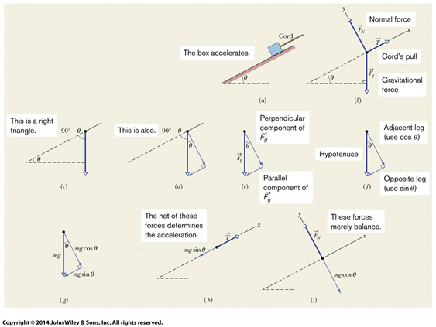
5-3 Applying Newton's Laws (10 of 10)
Sample Problem A block being pulled up a ramp:
Figure 5-15

Slide 46
5 Summary (1 of 5)
Newtonian Mechanics
Forces are pushes or pulls
Forces cause acceleration
Force
Vector quantities
Net force is the sum of all forces on a body

Slide 47
5 Summary (2 of 5)
Newton's First Law
If there is no net force on a body, the body remains at rest if it is initially at rest, or moves in a straight line at constant speed if it is in motion.
Inertial Reference Frames
Frames in which Newtonian mechanics holds

Slide 48
5 Summary (3 of 5)
Mass
The characteristic that relates the body's acceleration to the net force
Scalar quantity
Newton's Second Law
Equation (5-1)
Free-body diagram represents the forces on one object

Slide 49
5 Summary (4 of 5)
Some Particular Forces
Weight:
Equation (5-12)
Normal force from a surface
Friction along a surface
Tension in a cord

Slide 50
5 Summary (5 of 5)
Newton's Third Law
Law of force-pairs
If there is a force by B on C, then there is a force by C on B:
Equation (5-12)

Slide 51
Copyright
Copyright © 2018 John Wiley & Sons, Inc.
All rights reserved. Reproduction or translation of this work beyond that permitted in Section 117 of the 1976 United States Act without the express written permission of the copyright owner is unlawful. Request for further information should be addressed to the Permissions Department, John Wiley & Sons, Inc. The purchaser may make back-up copies for his/her own use only and not for distribution or resale. The Publisher assumes no responsibility for errors, omissions, or damages, caused by the use of these programs or from the use of the information contained herein.

